Slide 1
Recipe Recommendation System

Slide 2
Problem definition
We propose android and web based application which construct recommendation system by adding more heterogeneous information of recipes like cuisines, preparation direction, dietary etc.

Slide 3
Domain:
Machine learning
Image processing

Slide 4
Scope
The current approaches mostly focus on recognition of food category based on global dish appearance without explicit analysis of ingredient composition. Such approaches are incapable for retrieval of recipes with unknown food categories, a problem referred to as zero-shot retrieval. On the other hand, content-based retrieval without knowledge of food categories is also difficult to attain satisfactory performance due to large visual variations in food appearance and ingredient composition. So with reference to these problems , we propose our system to overcome limitations occurred in previous systems.

Slide 5
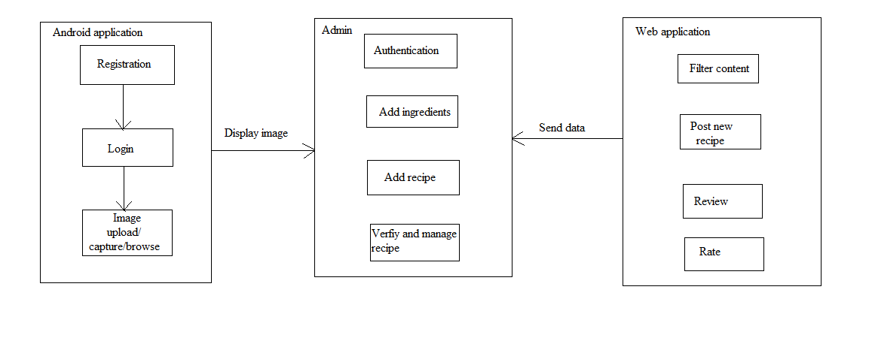
System Architecture

Slide 6
Software Requirements
Backend:- My SQL,
Wamp server
Operating System : Windows 10
Technology : Java, J2EE
Web Technologies : Html, JavaScript, CSS
Web Server : Wamp server
Database : My SQL
Java Version : J2SDK 1.7 / 1.8

Slide 7
Advantages
The recommended system item is something that the user has not seen in the past.
User get the food recipe suggestions according to the nutrition value.
User can add their, set own recipe in the database.
There are more and more users to use mobile application to get the cooking recipe information, but to recommend right recipe for each user is challenging for complex food and diet information.

Slide 8
References
IEEE Paper:
Constraint based recipe recommendation using forward checking algorithm.
Distributed representation of Dish Names in Food Related Web Services for associative search and nutrition estimation.
Recommendation system for alternative ingredients based on Co-occurrence Relation on Recipe Database and the Ingredients Category.

